Slide 1
AERATION
This is the process of bringing water into intimate contact with air to removes taste and odour and dissolved minerals
It may or may not be used for surface water because water is exposed to air. but it is provided compulsory to treat ground water. Efficiency of aeration depends on contact time and amount of surface contact b/w air and water.
OBJECTIVES or PURPOSES OR APPLICATIONS
The CO2 can be removed to an extent of 70%, & results in less corrosion of pipes.
It removes hydrogen sulphide & hence odour due to this gas is eliminated.
It increases dissolved Oxygen content in water.It precipitates iron & manganese especially from Ground water & removes.
It raises the pH of water.
Bacteria's may be killed to some extent.

Slide 2
Uses of providing aerator
In a surface-aerated system, the aerators provide two functions: they transfer air into the basins required by the biological oxidation reactions, and they provide the mixing required for dispersing the air and for contacting the reactants (that is, oxygen, wastewater and microbes).
What is the purpose of aeration in stp?
Aeration provides oxygen to bacteria for treating and stabilizing the wastewater.Oxygen is needed by the bacteria to allow biodegradation to occur. The supplied oxygen is utilised by bacteria in the wastewater to break down the organic matter containing carbon to form carbon dioxide and water.
The Purpose of Aeration is one of the most widely used tools for maintaining aquatic systems: wastewater treatment, improvement of number and health in fisheries, mosquito control, ice management, reduction of nutrient loading, sediment management, water clarity, and algae control.

Slide 3
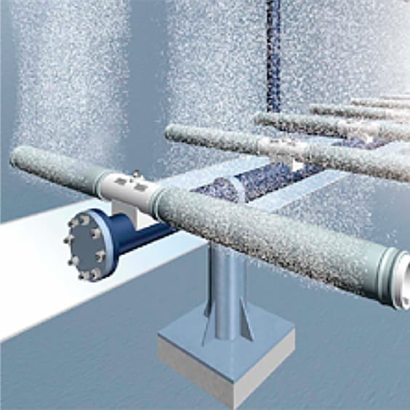
What are the use of air blower in STP?
The Purpose of Aeration is one of the most widely used tools for maintaining aquatic systems: wastewater treatment, improvement of number and health in fisheries, mosquito control, ice management, reduction of nutrient loading, sediment management, water clarity, and algae control.

Slide 4
In aeration tank the sewage water passing through zigzag way because to give time for sewage treatment. the micro-organisms must have DO at least 0.1to0.3 mg/l.bacteria and micro-organisms use dissolved oxygen to break
AETHUYFFF

Slide 5
THANK YOU

